Slide 1
Interactive Housing Price Predictor
November 2018

Slide 2
Problem Statement: Any house price prediction in current world needs huge amount of data processing & transformation which requires tremendous manual effort and time consuming process. Also it only gives the current price and predictions only based on certain fixed parameters like average sale price,sqft,bedrooms etc. Solution: Our predictive analytics BOT’s will predict how the sale price may change in future using current news trend analysis and slowly changing parameters like school rating,crime rate.

Slide 3
Key Features:
Interactive House Predictor Bot to predict local community houses.
Intake any image to extract and predict the price.
Continuous feed tracking for decision analytics.
Customer interaction tracker.

Slide 4














Data flow Architecture
AWS Lex
Panda Dataframe
Python Scipy ML
AWS S3
AWS Dynamo DB
AWS Kinesis
AWS Lambda
AWS Rekognition

Slide 5
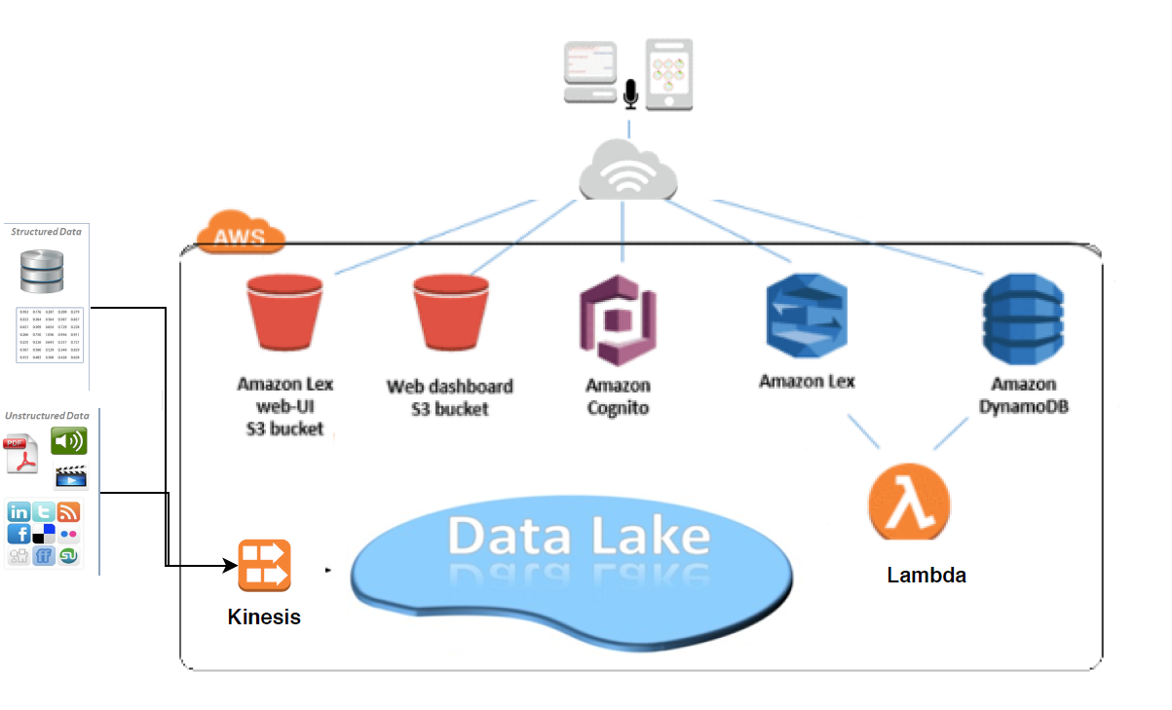

Workflow Architecture:

Slide 6
Technologies Used:
AWS Services Like Kinesis, Lex, Lambda, S3, DynamoDB, Cognito, Rekognition.
UI Experience – Web and Mobile app.

